Slide 1
Introduction to Particles

Slide 2
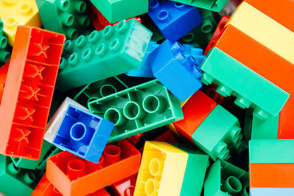
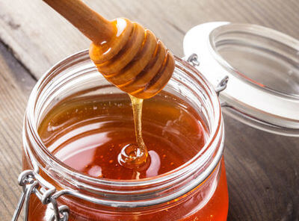
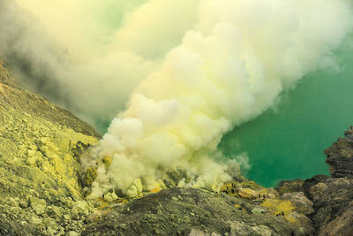
Welcome to this Smart Lesson on matter and particles! By the end of this lesson you should be able to:
Describe the three states of matter.
Compare how particles are packed together and how they move in each state of matter.
Define bonds and describe how they influence particle behaviour.

Slide 3


Everything in the world is made of matter.
Take a look around the room you're in: how many different things can you see? Do you see your computer, some books, pens, a drink bottle?
What can you see outside? Maybe trees, hills, buildings, people? What about things you can't see like air? What do all these things have in common?
They're all made of matter!

Slide 4
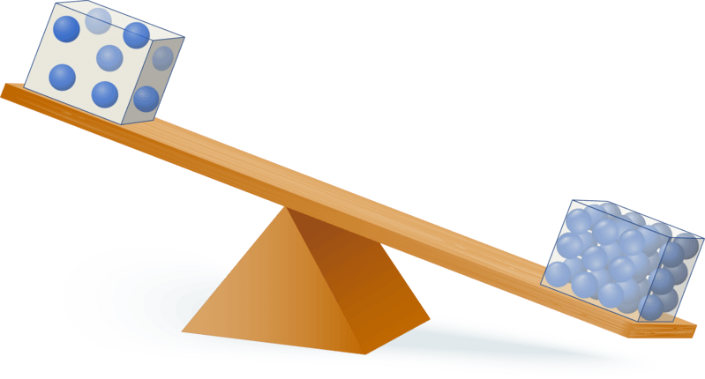
Matter is anything that has mass and volume.
Mass describes how much of an object there is. The more of an object there is, the heavier it will be.
Volume is the space an object takes up.

Slide 5
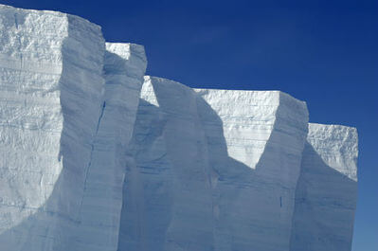

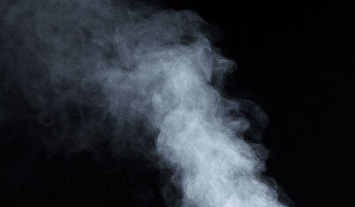
There are three main states of matter: solid, liquid or a gas.
Most matter exists as one of these three states.
There are other states of matter, including plasma which the sun is made of.

Slide 6

10 of 27
Matter is made of many tiny particles that are too small to see.
Particles are constantly moving.

Slide 7


Particles don't always behave the same way.
Particles can be close together or far apart.

Slide 8
Particles can also be held in place or moving around.
Even when they are held in place, particles will still be vibrating.

Slide 9
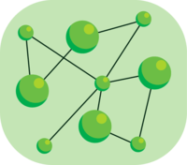
How a particle behaves is determined by its bonds.
Bonds are attractions between particles that hold them together.
Particles with few or no bonds will move around freely, but particles with many bonds will be held in place.

Slide 10
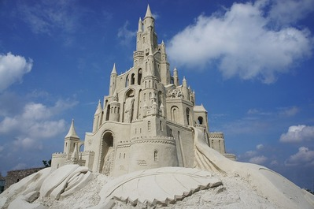

Solids have many bonds between their particles.
This means that solids have a definite shape that won't change without an external force. Solids also have a definite volume; they will always take up the same amount of space.

Slide 11
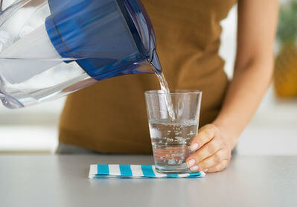
Liquids have some bonds between their particles.
This means that liquids have a definite volume, but not a definite shape. Liquids can spread out to take the shape of the container they're in.

Slide 12

Gases have no bonds between their particles.
Gases do not have a definite shape or a definite volume. Gases will spread out and expand to fill whatever container they’re in.

